Slide 1


JAYANTHI G
25.04.2025

Slide 2

Outline
Executive Summary
Introduction
Methodology
Results
Conclusion
Appendix

Slide 3
Executive Summary
The following methodologies were used to analyze data:
Data Collection using web scraping was done.
Exploratory Data Analysis (EDA), using SQlL and EDA for visualization were done.
Interactive visual analytics with folium lab was done.
An interactive dashboard using Plotly was created.
Predictive analysis using machine learning was done.
Summary of all results
It was possible to collected valuable data from public sources;
EDA allowed us to identify the best features for the successful landings.
Machine Learning prediction showed the best model for the successful launch of spacecraft using all collected data.

Slide 4
Introduction
The objective is to evaluate the viability of the new company Space Y to compete with Space X.
The scope of the project is to focus on variables like launch site, rocket type, payload mass, and mission outcome.
The possible best approach is to use data preprocessing, visualization, and predictive modeling techniques.
The expected outcome of this project is providing insights into launch performance and build a model to predict future launch success.

Slide 5

Section 1

Slide 6
Methodology
Executive Summary
Data collection methodology:
Data from Space X was obtained from 2 sources:
Space X API (https://api.spacexdata.com/v4/rockets/)
WebScraping (https://en.wikipedia.org/wiki/List_of_Falcon/_9/_and_Falcon_Heavy_launches)
Perform data wrangling
Collected data was enriched by creating a landing outcome label based on outcome data
after summarizing and analyzing features
Perform exploratory data analysis (EDA) using visualization and SQL

Slide 7
Methodology
Executive Summary – contd..
Perform interactive visual analytics using Folium and Plotly Dash
Perform predictive analysis using classification models
Data that was collected until this step were normalized, divided into training and test data sets and evaluated by four different classification models. The accuracy of each model was evaluated using different combinations of parameters.

Slide 8
Data Collection
Data sets were collected from Space X API. Hyperlink: https://api.spacexdata.com/v4/rockets/
Wikipedia was the other source of data collection
(https://en.wikipedia.org/wiki/List_of_Falcon/_9/_and_Falcon_Heavy_launches), using web scraping technics.

Slide 9
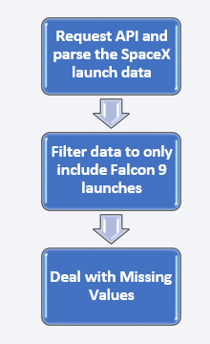
Data Collection – SpaceX API
SpaceX offers a public API from where data can be obtained and then used;
The data collected was filtered and the required data i.e. Falcon 9 launches was obtained.
Source code:
https://github.com/JayanthiGovindaraju/Applied-Data-Science-Capstone/blob/main/jupyter-labs-spacex-data-collection-api_module%201_part%201.ipynb
Request API and parse the SpaceX launch data

Slide 10
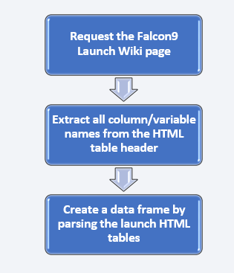
Data Collection - Scraping
Data about SpaceX launches can also be obtained from Wikipedia.
Data are downloaded from Wikipedia according to the flowchart and then persisted.
Source code:
https://github.com/JayanthiGovindaraju/Applied-Data-Science-Capstone/blob/main/jupyter-labs-webscraping_module%201_part%202.ipynb

Slide 11
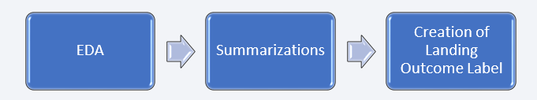
Data Wrangling
Exploratory Data Analysis (EDA) was performed on the dataset.
Launches per site, occurrences of each orbit and occurrences of mission outcome per orbit type were calculated.
Finally, the landing outcome label was created from Outcome column.
Source Code:
https://github.com/JayanthiGovindaraju/Applied-Data-Science-Capstone/blob/main/labs-jupyter-spacex-Data%20wrangling_module1_part%203.ipynb

Slide 12
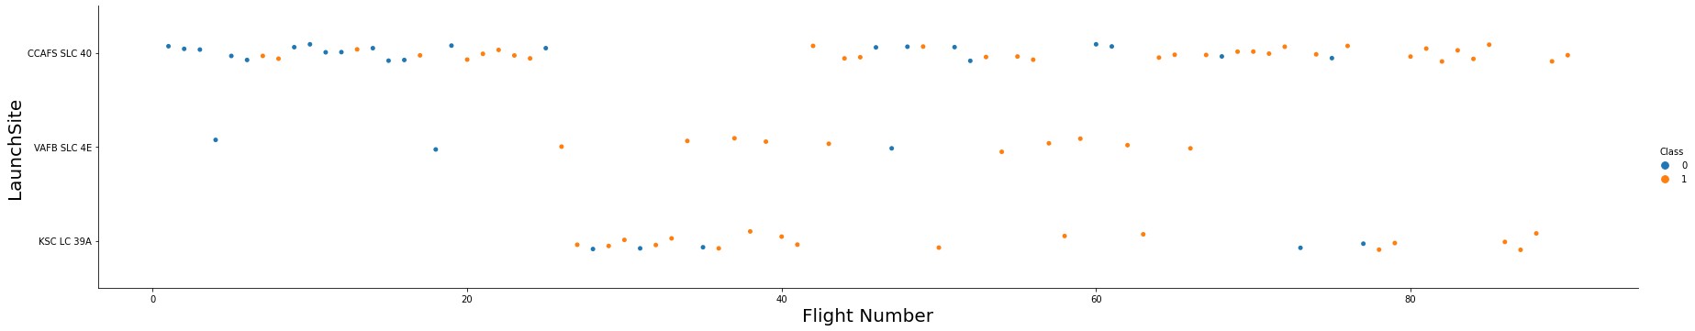
EDA with Data Visualization
To explore data, scatterplots and bar plots were used to visualize the relationship between pair of features:
Payload Mass X Flight Number, Launch Site X Flight Number, Launch Site X Payload Mass, Orbit and Flight Number, Payload and Orbit
Source code: https://github.com/JayanthiGovindaraju/Applied-Data-Science-Capstone/blob/main/edadataviz_module2_part%202.ipynb

Slide 13
EDA with SQL
The following SQL queries were performed:
Names of the unique launch sites in the space mission.
Top 5 launch sites whose name begin with the string 'CCA’.
Total payload mass carried by boosters launched by NASA (CRS).
Average payload mass carried by booster version F9 v1.1.
Date when the first successful landing outcome in ground pad was achieved.
Names of the boosters which have success in drone ship and have payload mass between 4000 and 6000 kg.
Total number of successful and failure mission outcomes.
Names of the booster versions which have carried the maximum payload mass.
Failed landing outcomes in drone ship, their booster versions, and launch site names for in
year 2015; and
Rank of the count of landing outcomes (such as Failure (drone ship) or Success (ground
pad)) between the date 2010-06-04 and 2017-03-20.
Source code: https://github.com/JayanthiGovindaraju/Applied-Data-Science-Capstone/blob/main/jupyter-labs-eda-sql-coursera_sqllite_module%202_part%201.ipynb
13

Slide 14
Build an Interactive Map with Folium
Markers, circles, lines and marker clusters were used with Folium Maps
Markers indicate points like launch sites
Circles indicate highlighted areas around specific coordinates, like NASA Johnson Space
Center
Marker clusters indicates groups of events in each coordinate, like launches in a launch site;
and
Lines are used to indicate distances between two coordinates.
Source code: https://github.com/JayanthiGovindaraju/Applied-Data-Science-Capstone/blob/main/lab_jupyter_launch_site_location_module%203_part%201.ipynb

Slide 15
Build a Dashboard with Plotly Dash
The following graphs and plots were used to visualize data
Percentage of launches by site
Payload range
This combination allowed to quickly analyze the relation between payloads and launch sites, helping to identify where is best place to launch according to payloads.
Source code: https://github.com/JayanthiGovindaraju/Applied-Data-Science-Capstone/blob/main/spacex-dash-app.py_module%203_part%202

Slide 16
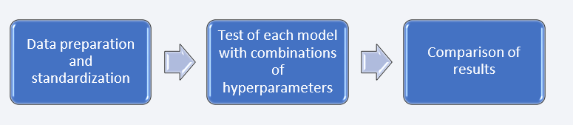
Predictive Analysis (Classification)
Four classification models were compared: logistic regression, support vector machine, decision tree and k nearest neighbors.
Source code: https://github.com/JayanthiGovindaraju/Applied-Data-Science-Capstone/blob/main/SpaceX_Machine%20Learning%20Prediction_module%204_part%201.ipynb

Slide 17
Results
Exploratory data analysis results:
Space X uses 4 different launch sites
The average payload of F9 v1.1 booster is 2,928 kg;
The first success landing outcome happened in 2015 fiver year after the first launch;
Many Falcon 9 booster versions were successful at landing in drone ships having payload above the average;
Almost 100% of mission outcomes were successful;
Two booster versions failed at landing in drone ships in 2015: F9 v1.1 B1012 and F9 v1.1 B1015;
The number of landing outcomes became as better as years passed.

Slide 18
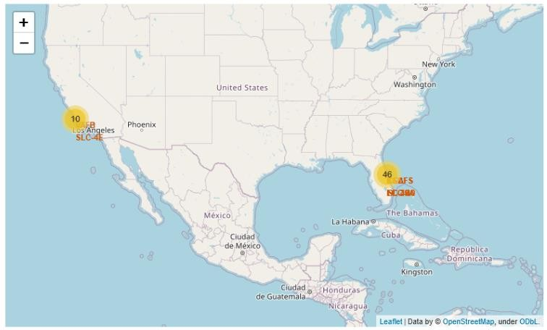
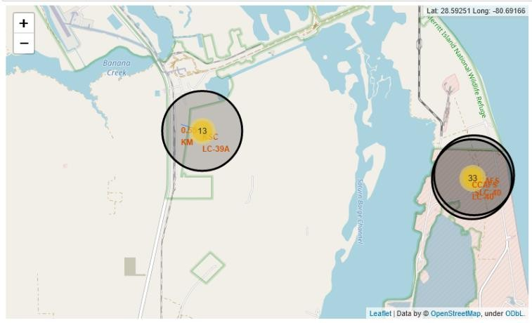
Results
Using interactive analytics, safe launch sites are identified to be used for launching such as, near sea, and also having a good logistic infrastructure around.
Most launches happens at east coast.

Slide 19
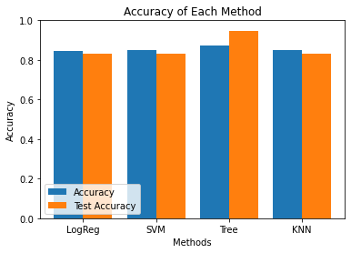
Results
Predictive Analysis showed that Decision Tree Classifier is the best model to predict successful landings, having accuracy over 87% and accuracy for test data over 94%.

Slide 20

Section 2

Slide 21
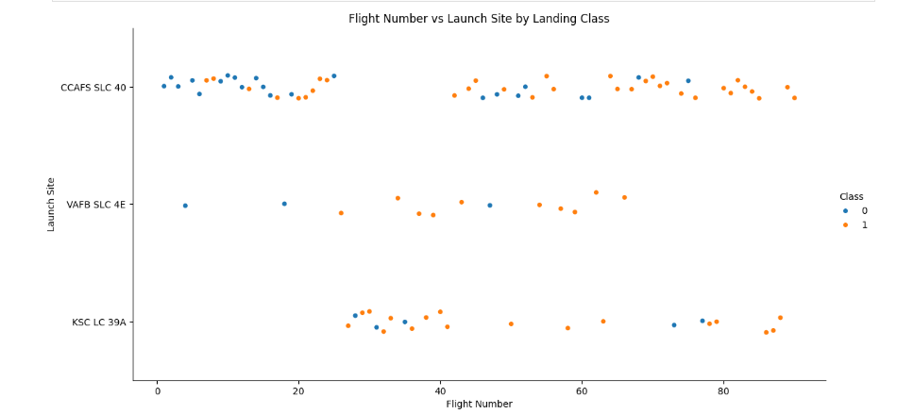
Flight Number vs. Launch Site
Scatter plot showing relationship between payload mass and launch success.
Blue and orange dots represent different outcomes (e.g., success and failure).
Clear clustering pattern based on payload ranges and outcomes.
Key Insights
Payload mass influences the likelihood of a successful launch.
Certain payload ranges show higher concentration of successes.
Some failures are scattered across low and mid payload values.
.

Slide 22
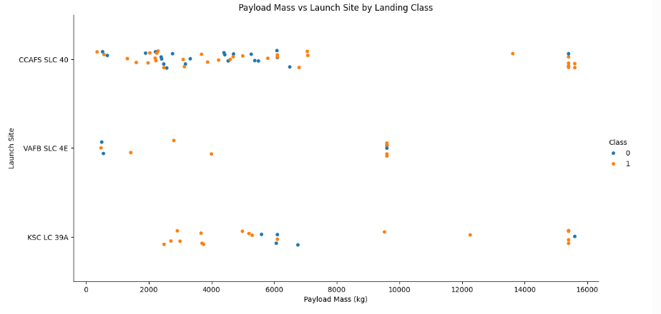
Payload vs. Launch Site
Scatter plot showing payload mass versus launch success/failure.
Blue and orange points represent different launch outcomes.
Payloads are distributed across different mass ranges with varying success rates.
Key Observations
Higher payloads show mixed outcomes, with a slight tendency toward failures.
Mid-range payloads generally have a higher success rate.
Dense clustering near specific payload weights suggests standard mission configurations.

Slide 23
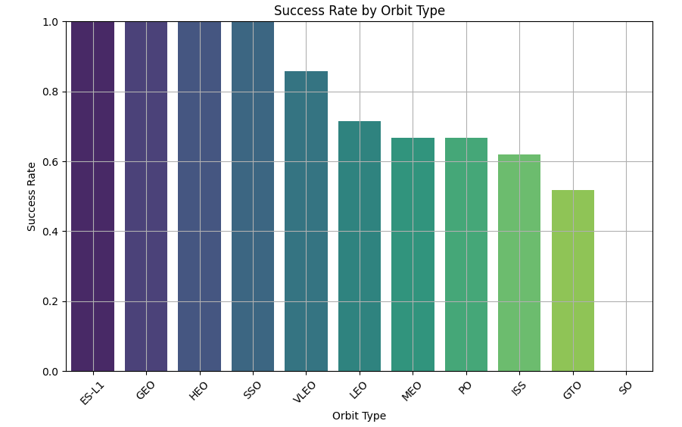
Success Rate vs. Orbit Type
Bar chart displaying launch success rates across different SpaceX launch sites.
Each bar represents the proportion of successful launches.
Key Insights
Some sites consistently achieve near-perfect success rates.
Variations hint at differences in site infrastructure, weather, or mission types.
Identifying high-performing launch sites helps optimize future operations.

Slide 24
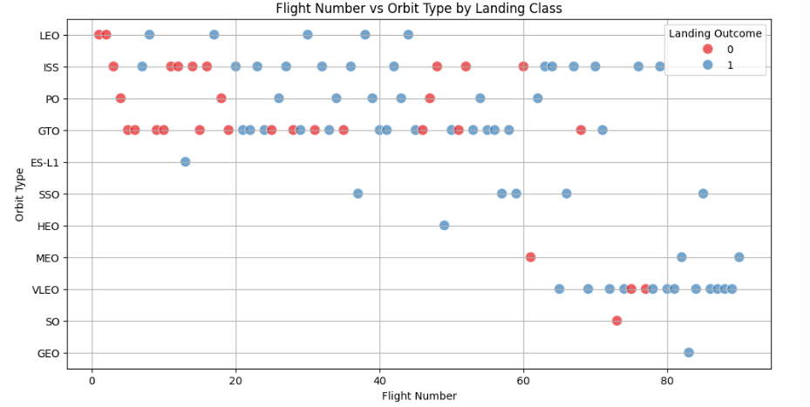
Flight Number vs. Orbit Type
Blue dots (1): Successful landings
Red dots (0): Failed landings
Orbits include LEO, ISS, GTO, MEO, etc.
Key Insights:
Most LEO and ISS missions show higher success rates as flight experience grows.
GTO orbits show a higher variability in landing outcomes.
Indicates learning curve and mission complexity effects.

Slide 25
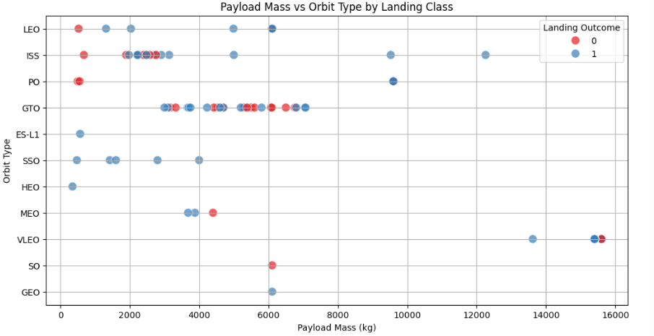
Payload vs. Orbit Type
Scatter plot showing how payload mass varies by orbit type and landing outcome.
Blue dots (1): Successful landings , ed dots (0): Failed
landingsPayload mass spans from small loads (~0 kg) to very heavy loads (~16,000 kg).
Key Insights:Lower payloads (< 4000 kg) are more common across multiple orbits (LEO, ISS, GTO).High-mass missions (> 10,000 kg) tend to have better landing success (mostly blue).
GTO orbits show diverse payloads and a mix of outcomes.

Slide 26
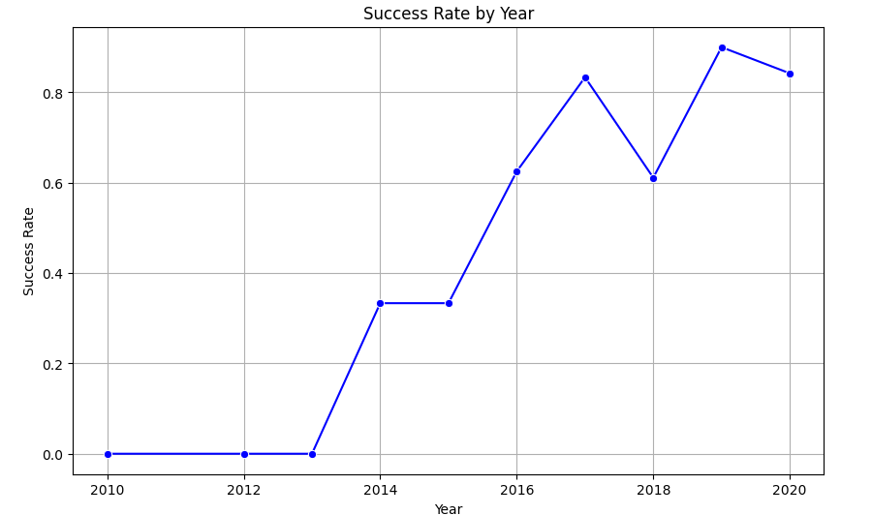
Launch Success Yearly Trend
Line graph showing how the landing success rate evolved year by year.
Notice the sharp improvement after 2015.Dips (like in 2018) suggest challenges, but overall trend is strongly upward.
Key Insights:2010–2013: No successful landings.2014–2016: Rapid improvement from 0% to over 60%.2017–2020:
Sustained high success rate (~80%-90%).Reflects advancements in technology, design, and experience.🎨 Design

Slide 27
All Launch Site Names
According to data, there are four launch sites:
Launch Site
CCAFS LC-40
CCAFS SLC-40
KSC LC-39A
VAFB SLC-4E
They are obtained by selecting unique occurrences of “launch_site” values
from the dataset.

Slide 28
Launch Site Names Begin with 'CCA'
5 records where launch sites begin with `CCA`:
Date | Time UTC | Booster Version | Launch Site | Payload | Payload Mass kg | Orbit | Customer | Mission Outcome | Landing Outcome
2010-06-04 | 18:45:00 | F9 v1.0 B0003 | CCAFS LC-40 | Dragon Spacecraft Qualification Unit | 0 | LEO | SpaceX | Success | Failure (parachute)
2010-12-08 | 15:43:00 | F9 v1.0 B0004 | CCAFS LC-40 | Dragon demo flight C1, two CubeSats, barrel of Brouere cheese | 0 | LEO (ISS) | NASA (COTS) NRO | Success | Failure (parachute)
2012-05-22 | 07:44:00 | F9 v1.0 B0005 | CCAFS LC-40 | Dragon demo flight C2 | 525 | LEO (ISS) | NASA (COTS) | Success | No attempt
2012-10-08 | 00:35:00 | F9 v1.0 B0006 | CCAFS LC-40 | SpaceX CRS-1 | 500 | LEO (ISS) | NASA (CRS) | Success | No attempt
2013-03-01 | 15:10:00 | F9 v1.0 B0007 | CCAFS LC-40 | SpaceX CRS-2 | 677 | LEO (ISS) | NASA (CRS) | Success | No attemp
Here we can see five samples of Cape Canaveral launches.

Slide 29
Total Payload Mass
Total payload carried by boosters from NASA:
Total Payload (kg)
111.268
Total payload calculated above, by summing all payloads whose codes
contain ‘CRS’, which corresponds to NASA.

Slide 30
Average Payload Mass by F9 v1.1
Average payload mass carried by booster version F9 v1.1:
Avg Payload (kg)
2.928
Filtering data by the booster version above and calculating the average
payload mass we obtained the value of 2,928 kg.

Slide 31
First Successful Ground Landing Date
First successful landing outcome on ground pad:
Min Date
2015-12-22
By filtering data by successful landing outcome on ground pad and getting the minimum value for date it’s possible to identify the first occurrence, that happened on 12/22/2015.

Slide 32
Successful Drone Ship Landing with Payload between 4000 and 6000
Boosters which have successfully landed on drone ship and had payload mass greater than 4000 but less than 6000
Booster Version
F9 FT B1021.2
F9 FT B1031.2
F9 FT B1022
F9 FT B1026
Selecting distinct booster versions according to the filters above, these 4 are the result.

Slide 33
Total Number of Successful and Failure Mission Outcomes
Number of successful and failure mission outcomes:
Mission Outcome | Occurrences
Success | 99
Success (payload status unclear) | 1
Failure (in flight) | 1
Grouping mission outcomes and counting records for each group led us to the summary above.

Slide 34
Boosters Carried Maximum Payload
Boosters which have carried the maximum payload mass
Booster Version (...)
F9 B5 B1048.4
F9 B5 B1048.5
F9 B5 B1049.4
F9 B5 B1049.5
F9 B5 B1049.7
F9 B5 B1051.3
Booster Version
F9 B5 B1051.4
F9 B5 B1051.6
F9 B5 B1056.4
F9 B5 B1058.3
F9 B5 B1060.2
F9 B5 B1060.3
These are the boosters which have carried the maximum payload mass registered in the dataset.

Slide 35
2015 Launch Records
Failed landing outcomes in drone ship, their booster versions, and launch site names for in year 2015
Booster Version | Launch Site
F9 v1.1 B1012 | CCAFS LC-40
F9 v1.1 B1015 | CCAFS LC-40
The list above has the only two occurrences.

Slide 36
Rank Landing Outcomes Between 2010-06-04 and 2017-03-20
Ranking of all landing outcomes between the date 2010-06-04 and 2017-
03-20:
Landing Outcome | Occurrences
No attempt | 10
Failure (drone ship) | 5
Success (drone ship) | 5
Controlled (ocean) | 3
Success (ground pad) | 3
Failure (parachute) | 2
Uncontrolled (ocean) | 2
Precluded (drone ship) | 1
This view of data alerts us that “No attempt” must be taken in account.

Slide 37

Section 3

Slide 38
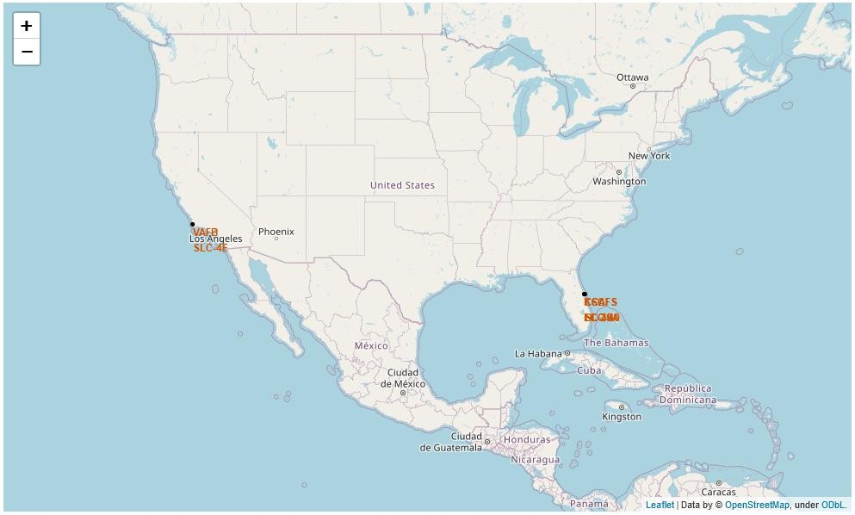
All launch sites
Launch sites are near sea, probably by safety, but not too far from roads and
railroads.

Slide 39

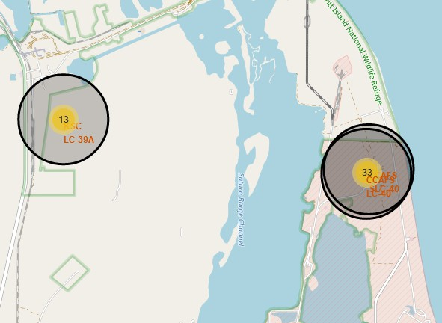
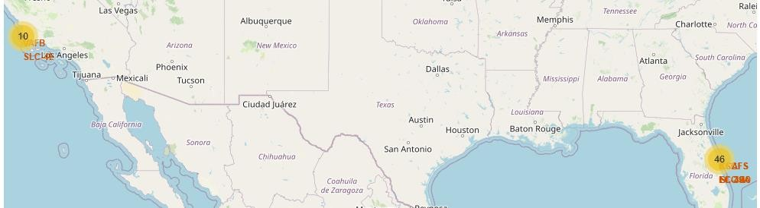

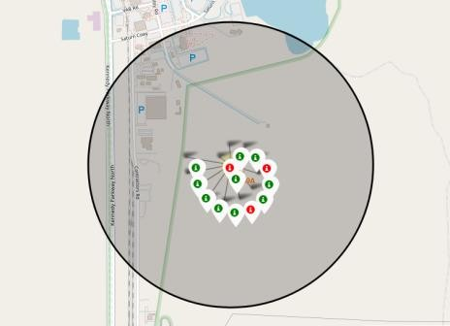
Launch Outcomes by Site
Example of KSC LC-39A launch site launch outcomes
Green markers indicate successful and red ones indicate failure.

Slide 40
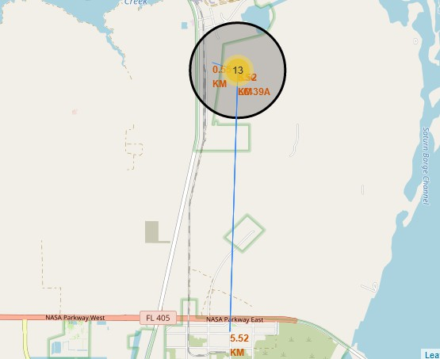
Logistics and Safety
Launch site KSC LC-39A has good logistics aspects, being near railroad and road and relatively far from inhabited areas.

Slide 41

Section 4

Slide 42
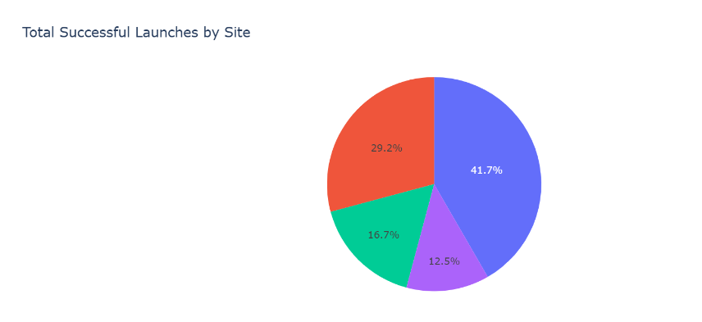
Successful Launches by Site
The place from where launches are done seems to be a very important factor of
success of missions.

Slide 43
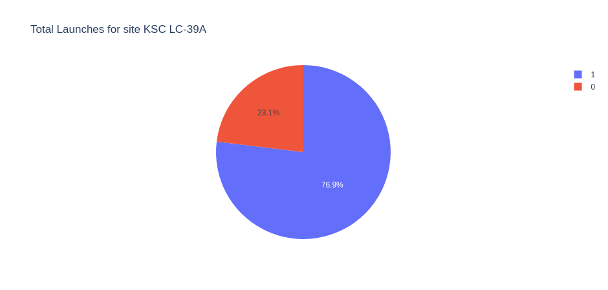
Launch Success Ratio for KSC LC-39A
76.9% of launches are successful in this site.

Slide 44
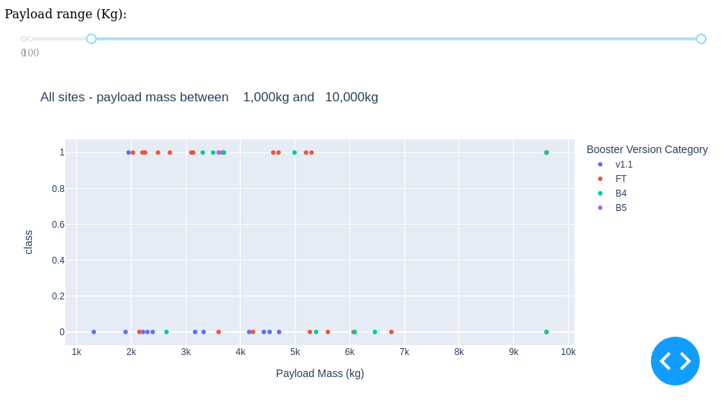
Payload vs. Launch Outcome
Payloads under 6,000kg and FT boosters are the most successful combination.

Slide 45
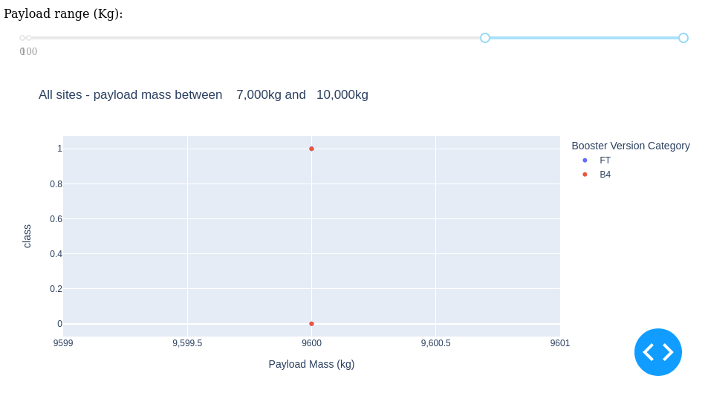
Payload vs. Launch Outcome
There’s not enough data to estimate risk of launches over 7,000kg

Slide 46

Section 5

Slide 47
Classification Accuracy
Four classification models were tested, and their accuracies are plotted beside;
The model with the highest classification accuracy is Decision Tree Classifier, which has accuracies over than 87%.

Slide 48
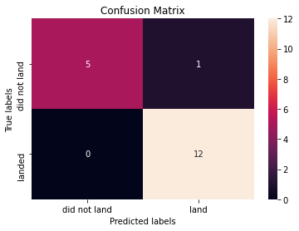
Confusion Matrix of Decision Tree Classifier
Confusion matrix of Decision Tree Classifier proves its accuracy by showing the big
numbers of true positive and true negative compared to the false ones.

Slide 49
Conclusions
Different data sources were analyzed, refining conclusions along the
process;
The best launch site is KSC LC-39A;
Launches above 7,000kg are less risky;
Although most of mission outcomes are successful, successful landing outcomes seem to improve over time, according the evolution of processes and rockets;
Decision Tree Classifier can be used to predict successful landings and
increase profits.

Slide 50
Appendix
As an improvement for model tests, it’s important to set a value to
np.random.seed variable;
Folium didn’t show maps on Github, so I took screenshots.

Slide 51


